Slide 1

Library study group
Camiel Verdult & Marnix Laar

Slide 2
What did we do for this topic?
We went to the Library
Studied

Slide 3


Slide 4
All jokes aside, what did we do?
Studied some of the standard library types
Ended up making our own!
- Vector - Pair - Map

Slide 5
Standard Library? What the heck is that?

Slide 6
Standard Library? What the heck is that?
std::string
std::cout
std::vector
std::copy()
std::sort()
std::move()

Slide 7
Standard Library? What the heck is that?
This part (the std namespace)
std::string
std::cout
std::vector
std::copy()
std::sort()
std::move()

Slide 8
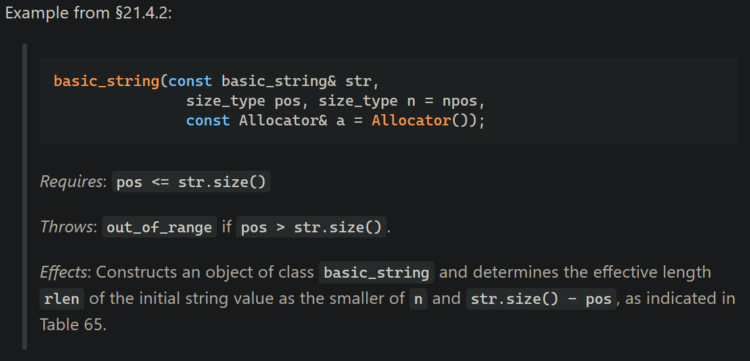
Who makes the standard library?
ISO standardized
Dictates:
The declaration and expected behavior
The side effects and conditions
Implementations’ underlying code may differ

Slide 9
Standard Library – implementations
GNU C++ Standard Library (libstdc++)
LLVM C++ Standard Library (libc++) (one of the most popular, comes with clang and mingw)
NVIDIA C++ Standard Library (libcu++)
Microsoft C++ Standard Library (MSVC STL)
Electronic Arts Standard Template Library (EASTL)
Abseil (Google)
Folly (Facebook)

Slide 10
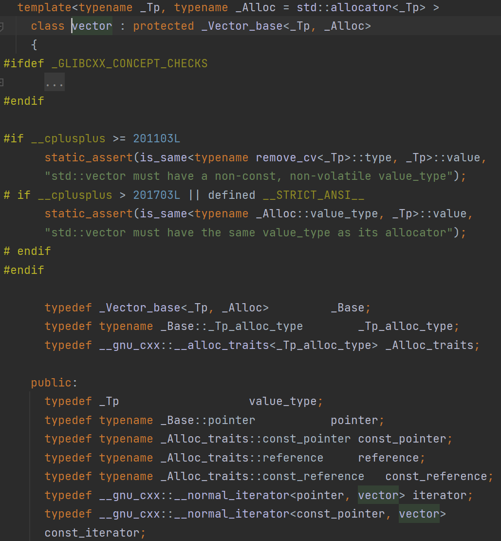
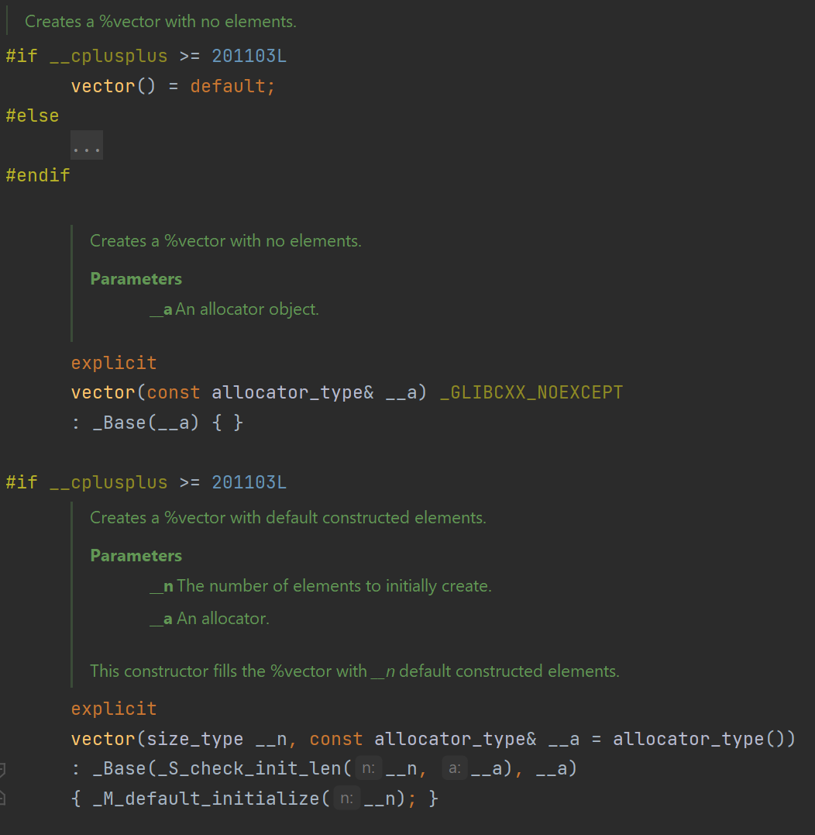
LLVM Standard Library vector implementation
(aka template hell)

Slide 11

Looking at the std::vector implementation

Slide 12
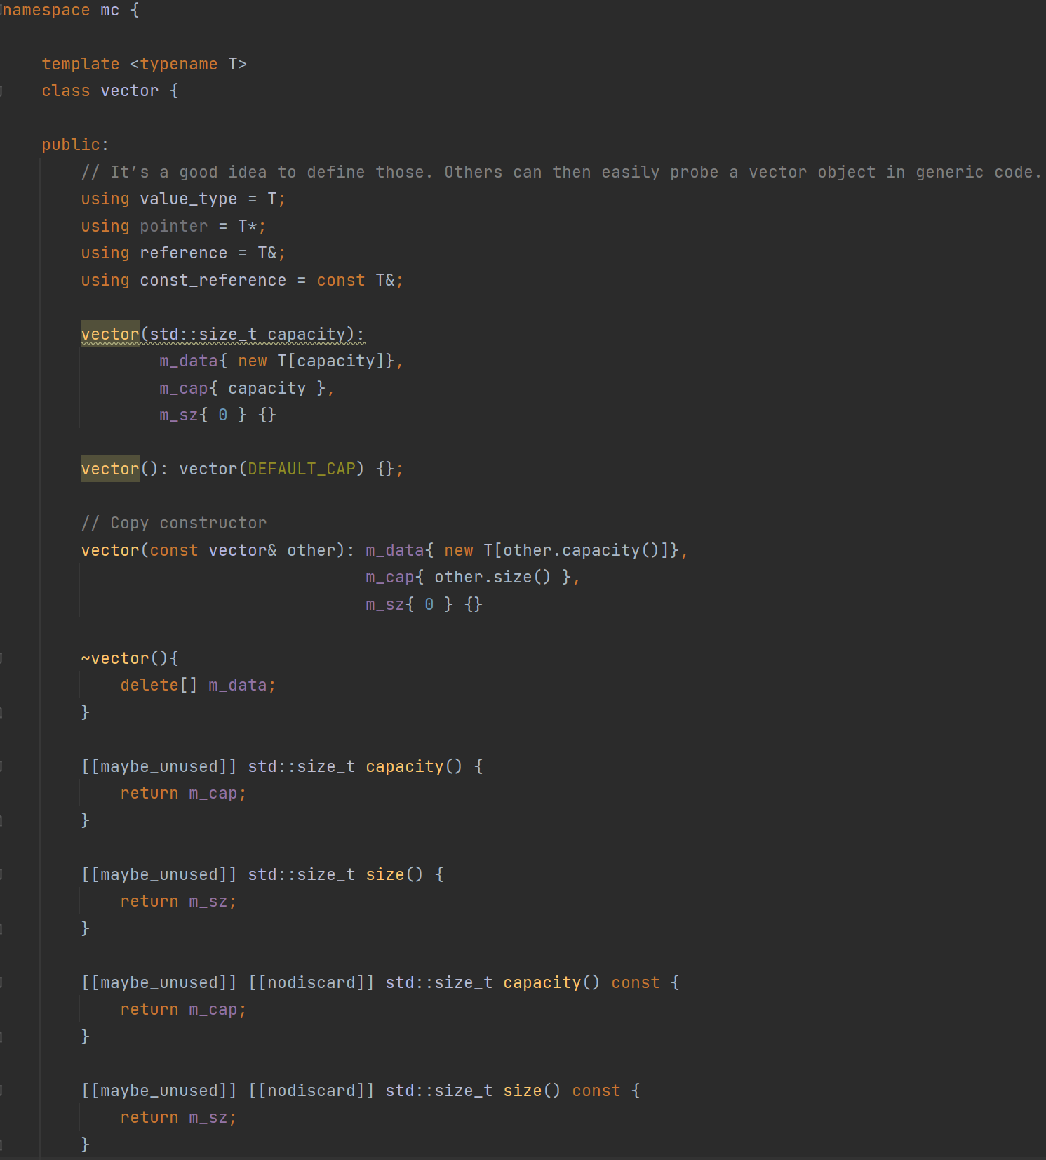
Our own (readable) vector “implementation”

Slide 13
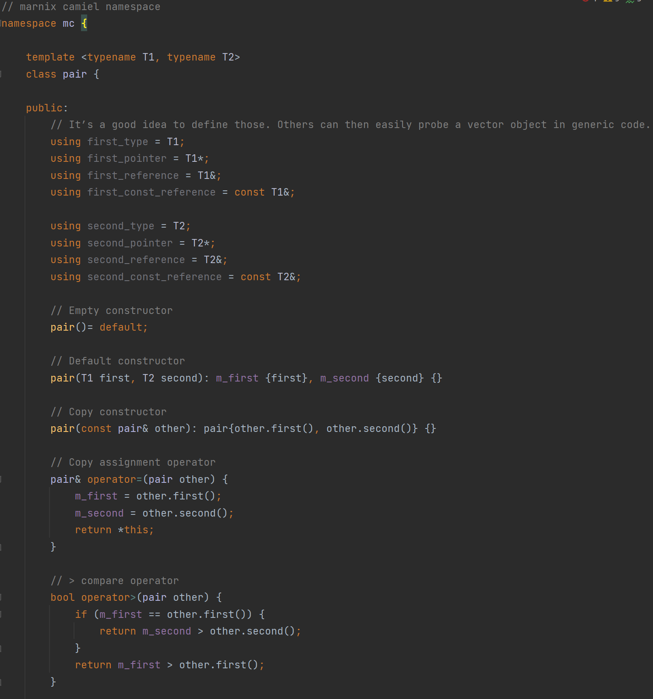
Our own (readable) pair “implementation”

Slide 14
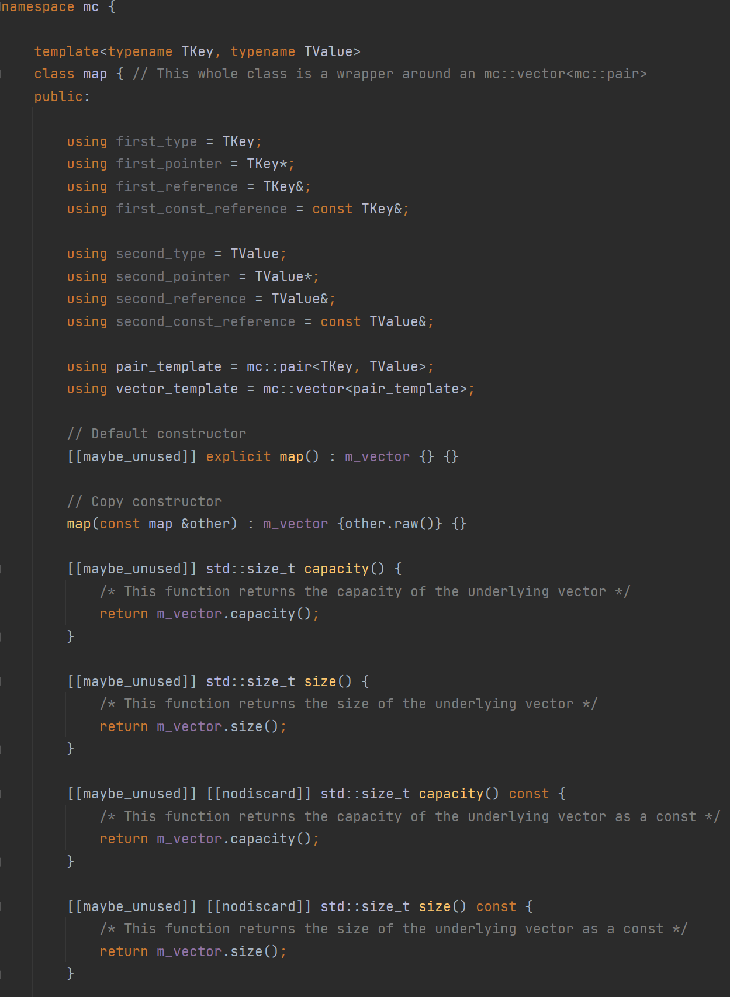
Our own (readable) map “implementation”

Slide 15
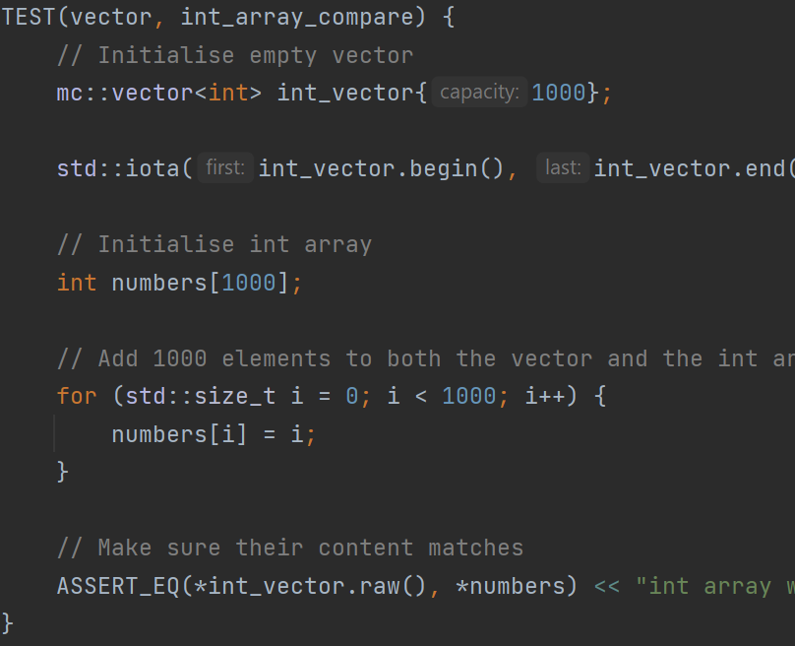

Google Tests

Slide 16

Missing functionality
mc::vector:
Initializer list constructor
mc::map:
Red-black tree data storage

Slide 17
Things we have implemented so far
mc::vector:
begin() and end() for std algorithm compatibility
sort() as a built-in function
print() and operator<< for debugging
most things you might use an std::vector for
mc::pair:
I think everything defined in the standard?
mc::map:
Storage datatype is mc::vector instead of Red-Black Tree (would be out of scope for this topic)
Implementation based on mc::vector

